Slide 1


CRYPTOGRAPHY (CTG)
Diploma in Cybersecurity and Digital Forensics (Dip in CSF)
Academic Year (AY) `21/`22 – Semester 2
Week 4.2
Combining Symmetric - Asymmetric Key cryptosystems
Cryptographic hash functions
Digital signatures
Last Updated: 15/10/2021

Slide 2
Contents
Recap – Week 4.1
Limitations of Asymmetric Key Cryptosystem?
Combining Symmetric and Asymmetric Key Cryptosystems
Cryptographic Hash Functions
Summary
Digital Signatures
Kid-RSA Exercises

Slide 3
Recap – Week 4.1

Slide 4



Symmetric Key Cryptosystem - Confidentiality
Feedback Component
Message from Sender to Receiver, must satisfy confidentiality, using symmetric key cryptosystem
Cipher Text
Encryption Algorithm
Decryption Algorithm
Message
Message
Sender
Receiver
Symmetric Key
Symmetric Key

Slide 5
Draw a figure: ASKC - Confidentiality
Thinking & Activity Component
Message from Sender to Receiver, must satisfy confidentiality, using asymmetric key cryptosystem

Slide 6
Fill up the table:
Thinking & Activity Component
 | Confidentiality | Integrity | Availability | Authentication | Non-Repudiation
Symmetric Key Cryptosystem | Yes/No? | Yes/No? | Yes/No? | Yes/No? | Yes/No?
Asymmetric Key Cryptosystem | Yes/No? | Yes/No? | Yes/No? | Yes/No? | Yes/No?

Slide 7
Limitations of Asymmetric Key Cryptosystems

Slide 8
Limitations of Asymmetric Key Cryptosystems
Knowledge Component
Longer Key Length
Asymmetric Key Cryptosystems uses longer keys than symmetric encryption.
The effectiveness of public key cryptosystems depends on the intractability (computational and theoretical) of certain mathematical problems such as integer factorization. These problems are time consuming to solve, but usually faster than trying all possible keys by brute force. Thus, asymmetric algorithm keys must be longer for equivalent resistance to attack than symmetric algorithm keys.
Symmetric Key Cryptosystem – AES
128 bit, 192 bit, and 256 bit key lengths
Asymmetric Key – RSA
1024 bit, 2048 bit, 3072 bit, 15360 bit
NIST key management guidelines suggest that 15360-bit RSA keys are equivalent in strength to 256-bit symmetric keys.
Source: http://en.wikipedia.org/wiki/Key_size

Slide 9
Limitations of Asymmetric Key Cryptosystems
Knowledge Component
Slower Encryption Speed
Asymmetric encryption is slower than symmetric encryption due to
longer key lengths
complexity of the encryption algorithms used.
Both of these requirements are due to the fact that one of the keys is public. In order to maintain security, asymmetric encryption must make it too difficult for a hacker to crack the public key and discover the private key.
Source: http://www.ehow.com/info_8659272_disadvantages-asymmetric-encryption.html

Slide 10
Limitations of Asymmetric Key Cryptosystems
Knowledge Component
Asymmetric Key Cryptosystems are incredibly slow.
They are not designed as a full-speed data transport cipher.
Therefore we can only encrypt "messages" of limited size
Foe example: encrypt data as large as the RSA key length.
For a 2048 bit RSA key, you can only encrypt messages up to 1960 bits (245 bytes) long
So how to achieve authentication, non-repudiation, and confidentiality if we want to send a large file/message (e.g., 1 MB sized file)?

Slide 11
Combining Symmetric and Asymmetric Key Cryptosystems

Slide 12
Draw a figure: Combine SKE & ASKE – Confidentiality, Secure Key Transfer
Thinking & Activity Component
A large Message from Sender to Receiver, must satisfy confidentiality and secure key transfer

Slide 13
Symmetric vs. Asymmetric
Knowledge Component
Uses a secret key to encrypt and to decrypt messages. | Uses two keys, one by the sender and one by the receiver to encrypt and to decrypt messages respectively. The two keys are mathematically related.
The secret key cannot be made public and known only to the sender and receiver. | One of the keys, i.e. the public key can be made known to all parties concerned. While the sender keeps the other key, i.e. private key.
Need a secure channel to distribute the key. | Allows public keys to be exchanged out in the open over insecure communication channels.
Perform faster than most public key cryptographic algorithms. | Perform slower than most symmetric cryptographic algorithms.
Number of symmetric keys = N(N-1)/2, where N is the number of users in the group | Number of Asymmetric Keys = 2N, where N is the number of users in the group
Satisfies only Confidentiality, Availability | Satisfies Confidentiality, Availability, Authentication, Non-Repudiation

Slide 14
Cryptographic Hash Functions

Slide 15
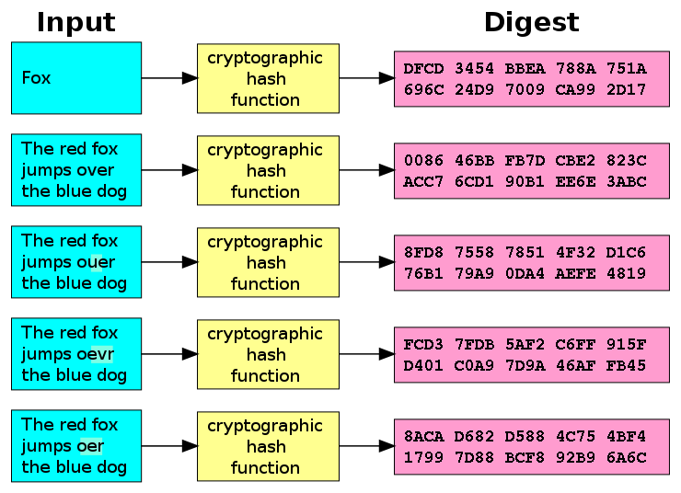
Cryptographic Hash Functions
Knowledge Component
Used for creating a unique digital fingerprint for a set of data
The output of a cryptographic hash function cannot be used to reveal original data set
Primarily used for comparison purposes
Output
Hash
Source: SECURITY+ GUIDE TO NETWORK SECURITY FUNDAMENTALS - 4th Edition – Mark Ciampa - Cengage Learning
Source: http://commons.wikimedia.org/wiki/File:Cryptographic_Hash_Function.svg

Slide 16
Example of Hash Function (1/2)
Knowledge Component
Example of hashing (ATMs)
Bank customer has PIN of 93542
Number is hashed and result stored on card’s magnetic stripe
User inserts card in ATM and enters PIN
ATM hashes the pin using the same algorithm that was used to store PIN on the card
If two values match, user may access ATM
(Source: SECURITY+ GUIDE TO NETWORK SECURITY FUNDAMENTALS - 4th Edition – Mark Ciampa - Cengage Learning )

Slide 17
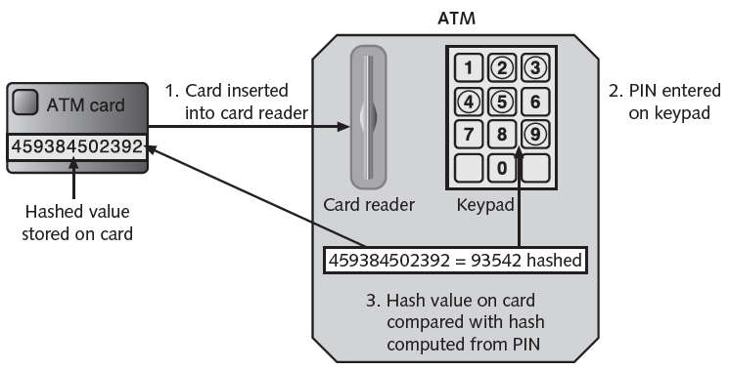
Example of Hash Function (2/2)
Knowledge Component
(Source: SECURITY+ GUIDE TO NETWORK SECURITY FUNDAMENTALS - 4th Edition – Mark Ciampa - Cengage Learning )

Slide 18
Activity
Knowledge Component
Open two web browser windows
In both the windows, Visit
http://www.fileformat.info/tool/hash.htm
This website lists several hash functions and their output
In one window
Type any text into “String Hash”
Observe the “Results”
In the second window
Slightly modify the above text by adding - . , : / ? “
Observe the “Results”
What do you infer from both the “Results” in terms of
Size of the result
Uniqueness of the result

Slide 19
Characteristics of Cryptographic Hash Functions
Knowledge Component
Secure hashing algorithm characteristics
Fixed size
Short and long data sets have the same size hash
Unique
Two different data sets cannot produce the same hash
Original
Dataset cannot be created to have a predefined hash
Secure
Resulting hash cannot be reversed to determine original plaintext
(Source: SECURITY+ GUIDE TO NETWORK SECURITY FUNDAMENTALS - 4th Edition – Mark Ciampa - Cengage Learning )

Slide 20
Applications of Hash Functions (1/2)
Knowledge Component
Hashing used to determine message integrity
Digital Signatures / Digital Signing
Can protect against man-in-the-middle attacks
Hashed Message Authentication Code (HMAC)
Hash variation providing improved security
Uses secret key possessed by sender and receiver
Receiver uses key to decrypt the hash
Hash values often posted on download sites
To verify file integrity after download
(Source: SECURITY+ GUIDE TO NETWORK SECURITY FUNDAMENTALS - 4th Edition – Mark Ciampa - Cengage Learning )

Slide 21
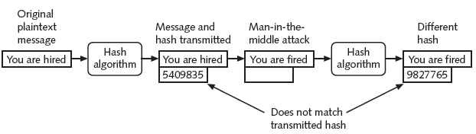
Applications of Hash Functions (2/2)
Knowledge Component
(Source: SECURITY+ GUIDE TO NETWORK SECURITY FUNDAMENTALS - 4th Edition – Mark Ciampa - Cengage Learning )

Slide 22
Popular Hash Functions (1/2)
Knowledge Component
Most common hash algorithms
Secure Hash Algorithm
Message Digest
Whirlpool
RIPEMD
Password hashes
In the previous Activity you can see various Hash Functions in the “Results” section.
(Source: SECURITY+ GUIDE TO NETWORK SECURITY FUNDAMENTALS - 4th Edition – Mark Ciampa - Cengage Learning )

Slide 23
Popular Hash Functions (2/2)
Knowledge Component
Message Digest 5
Weaknesses in compression function could lead to collisions
Secure Hash Algorithm (SHA)
More secure than MD
No weaknesses identified
SHA-1, SHA-2, SHA-3
SHA-1 to be phased out gradually by 2017
SHA-2
The SHA-2 family consists of six hash functions with digests (hash values) that are 224, 256, 384 or 512 bits
(Source: SECURITY+ GUIDE TO NETWORK SECURITY FUNDAMENTALS - 4th Edition – Mark Ciampa - Cengage Learning )

Slide 24
Digital Signature
How to digitally sign a message?
How to verify a digitally signed message?
Combining Digital Signature with Symmetric Key Cryptosystem
Limitation of a digital signature

Slide 25
Digital Signature
Knowledge Component
Verifies the sender
Authentication
Prevents sender from disowning the message
Non-Repudiation
Proves message integrity
Integrity

Slide 26
How to digitally sign a message?
Knowledge Component
Msg.
Hash Algorithm
Msg. Digest
Encryption Algorithm
Digital Signature
Sender
Step 1
Sender’s Private Key
Step 2
Attach Digital Signature to the Message
Digitally Signed Message
Msg.
Msg.
Digital Signature
Digital Signature
Sender
Receiver

Slide 27

How to verify a digitally signed message?
Knowledge Component
Digitally Signed Message from Sender
Separate Message & Digital Signature
Msg.
Msg.
Hash Algorithm
Msg. Digest 1
Receiver
Digital Signature
Digital Signature
Do digests 1&2 match?
then Message is Verified
If not: Message Unverified
Decryption Algorithm
Msg. Digest 2
Sender’s Public Key

Slide 28
How to ensure Integrity, Authenticity, and Non-Repudiation of a message?
Thinking & Knowledge Component
Describe in your own words

Slide 29
Fill up the table:
Thinking & Knowledge Component
 | Confidentiality | Integrity | Availability | Authentication | Non-Repudiation
Symmetric Key Cryptosystem | Yes/No? | Yes/No? | Yes/No? | Yes/No? | Yes/No?
Asymmetric Key Cryptosystem | Yes/No? | Yes/No? | Yes/No? | Yes/No? | Yes/No?
Digital Signature | Yes/No? | Yes/No? | Yes/No? | Yes/No? | Yes/No?

Slide 30
Draw a figure: Digital Signature + Symmetric – Asymmetric Key Cryptosystem
Thinking & Knowledge Component | Reflecting: LCL Approach
Message from Sender to Receiver, must satisfy confidentiality, integrity, authenticity, and non-repudiation using digital signature and symmetric key cryptosystem

Slide 31
Fill up the table:
Thinking & Knowledge Component
 | Confidentiality | Integrity | Availability | Authentication | Non-Repudiation
Symmetric Key Cryptosystem | Yes/No? | Yes/No? | Yes/No? | Yes/No? | Yes/No?
Asymmetric Key Cryptosystem | Yes/No? | Yes/No? | Yes/No? | Yes/No? | Yes/No?
Digital Signature | Yes/No? | Yes/No? | Yes/No? | Yes/No? | Yes/No?
Digital Signature + Symmetric-Asymmetric Key Cryptosystem | Yes/No? | Yes/No? | Yes/No? | Yes/No? | Yes/No?

Slide 32
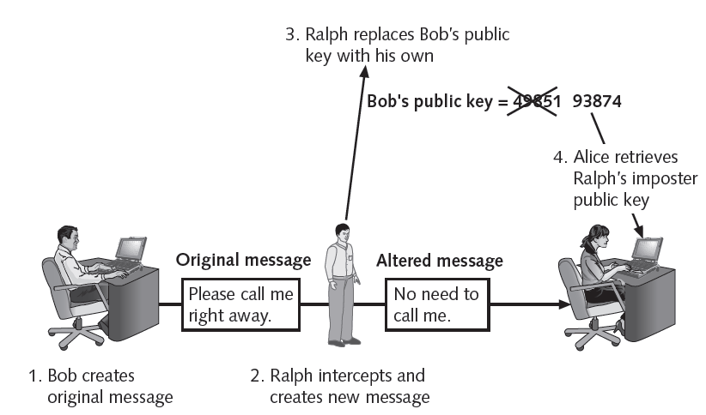
Limitation of a Digital Signature
Knowledge Component
Hacker could post his own public key under a sender’s name
To overcome this limitation we require Digital Certificates (to be learned next in lesson)

Slide 33
Summary

Slide 34
Summary
Component | You learnt
Knowledge | Limitations of Asymmetric Key Cryptosystems Cryptographic Hash Functions Example of Hash Functions Characteristics of Hash Functions Applications of Hash Functions Popular Hash Functions Digital Signatures How to Digitally Sign and Verify a Message?
Thinking | Asymmetric Key Cryptosystem – Confidentiality Goals of Cryptography Combining Symmetric and Asymmetric Key Cryptosystems Symmetric vs. Asymmetric Key Cryptosystem How to ensure Integrity, Authenticity, and Non-Repudiation of a message? Draw a figure: Digital Signature + Symmetric – Asymmetric Key Cryptosystem
Skill | Drawing the flow diagrams for cryptosystems
Activity | Cryptographic Hash Functions
Feedback | Symmetric Key Cryptosystem – Confidentiality Asymmetric Key Cryptosystem – Confidentiality Goals of Cryptography Combining Symmetric and Asymmetric Key Cryptosystems How to ensure Integrity, Authenticity, and Non-Repudiation of a message? Draw a figure: Digital Signature + Symmetric – Asymmetric Key Cryptosystem

Slide 35
Kid-RSA Exercises

Slide 36
Kid-RSA: Exercise
Let: a = 5, b = 6, a1 = 7, b1 = 8;
PT = 10
CT = ???
PT = 750
CT = ???
PT = 1000
CT = ???
Also decrypt the CTs and see if you are able to get back the PTs

